Slide 1
Art for Heart’s Sake
Erasmus + KA220-SCH
Cooperation partnerships in school education

Slide 2
What is our project about?
This a 3 year project (September 2023 – August 2026), involving 6 schools from across Europe, to use the creative arts to positively impact schools’ ability to meet the needs of diverse groups.
The project objectives are to promote inclusion and diversity and enhance key competences. These will be achieved through participation in creative arts. The project will particularly support disadvantaged and marginalised participants and those who suffer from poor mental health. It will promote creativity and its benefits, in all our organisations.
The activities will be an exploration of individual countries’ cultural arts heritage, plus a collaboration to create a fusion of this knowledge into innovative arts resources: a playscript, dances, musical pieces, costumes, scenery, artworks, digital media and performance.

Slide 3
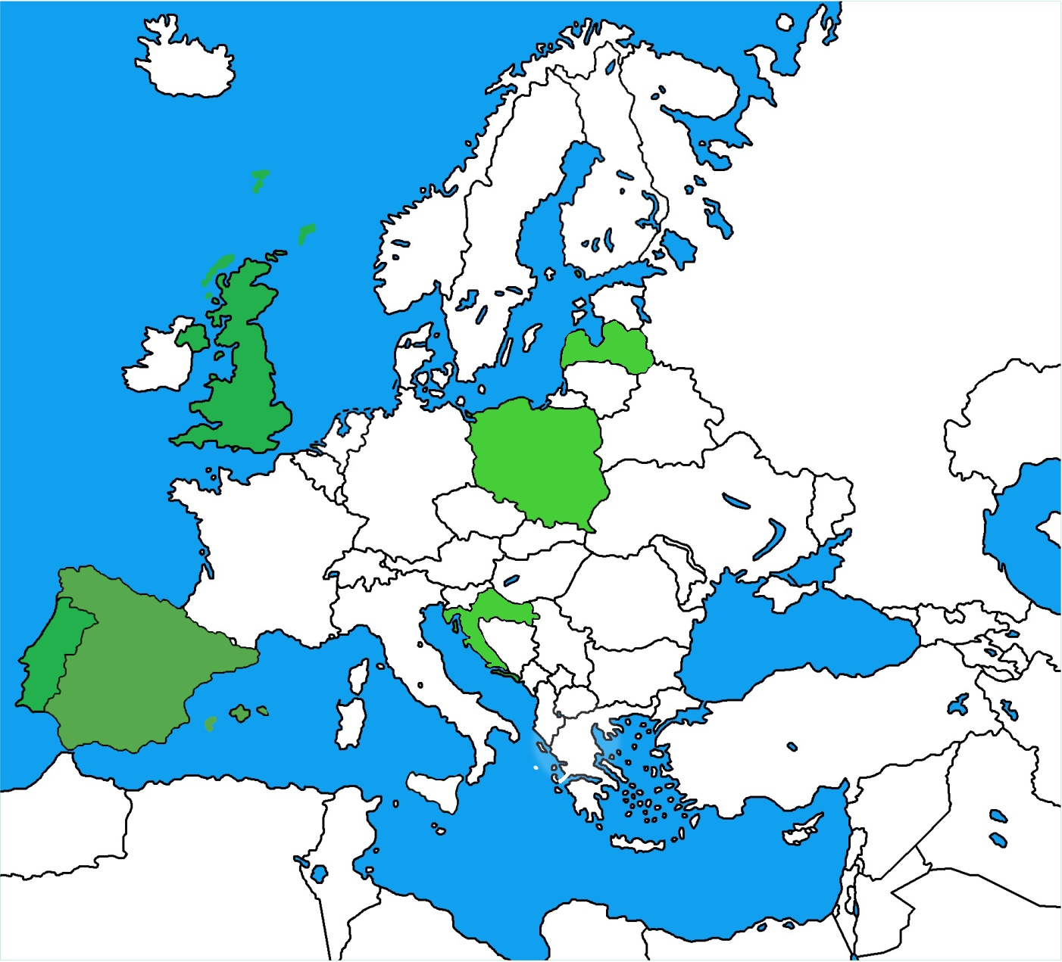
Where are the project partner schools?
Madonas pilsetas vidusskola, Madona - LATVIA
.
Sherborne C of E Primary School, Sherborne - ENGLAND (UK)
Szkola Podstawowa nr 42 im. Jana Brzechwy, Częstochowa - POLAND
.
Escola Básica Gonçalo Mendes da Maia, Maia - PORTUGAL
Osnovna skola Vladimir Nazor, Duga Resa - CROATIA
Bec De L'Àguila, San Vicente - SPAIN
.

Slide 4
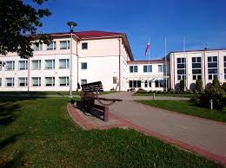
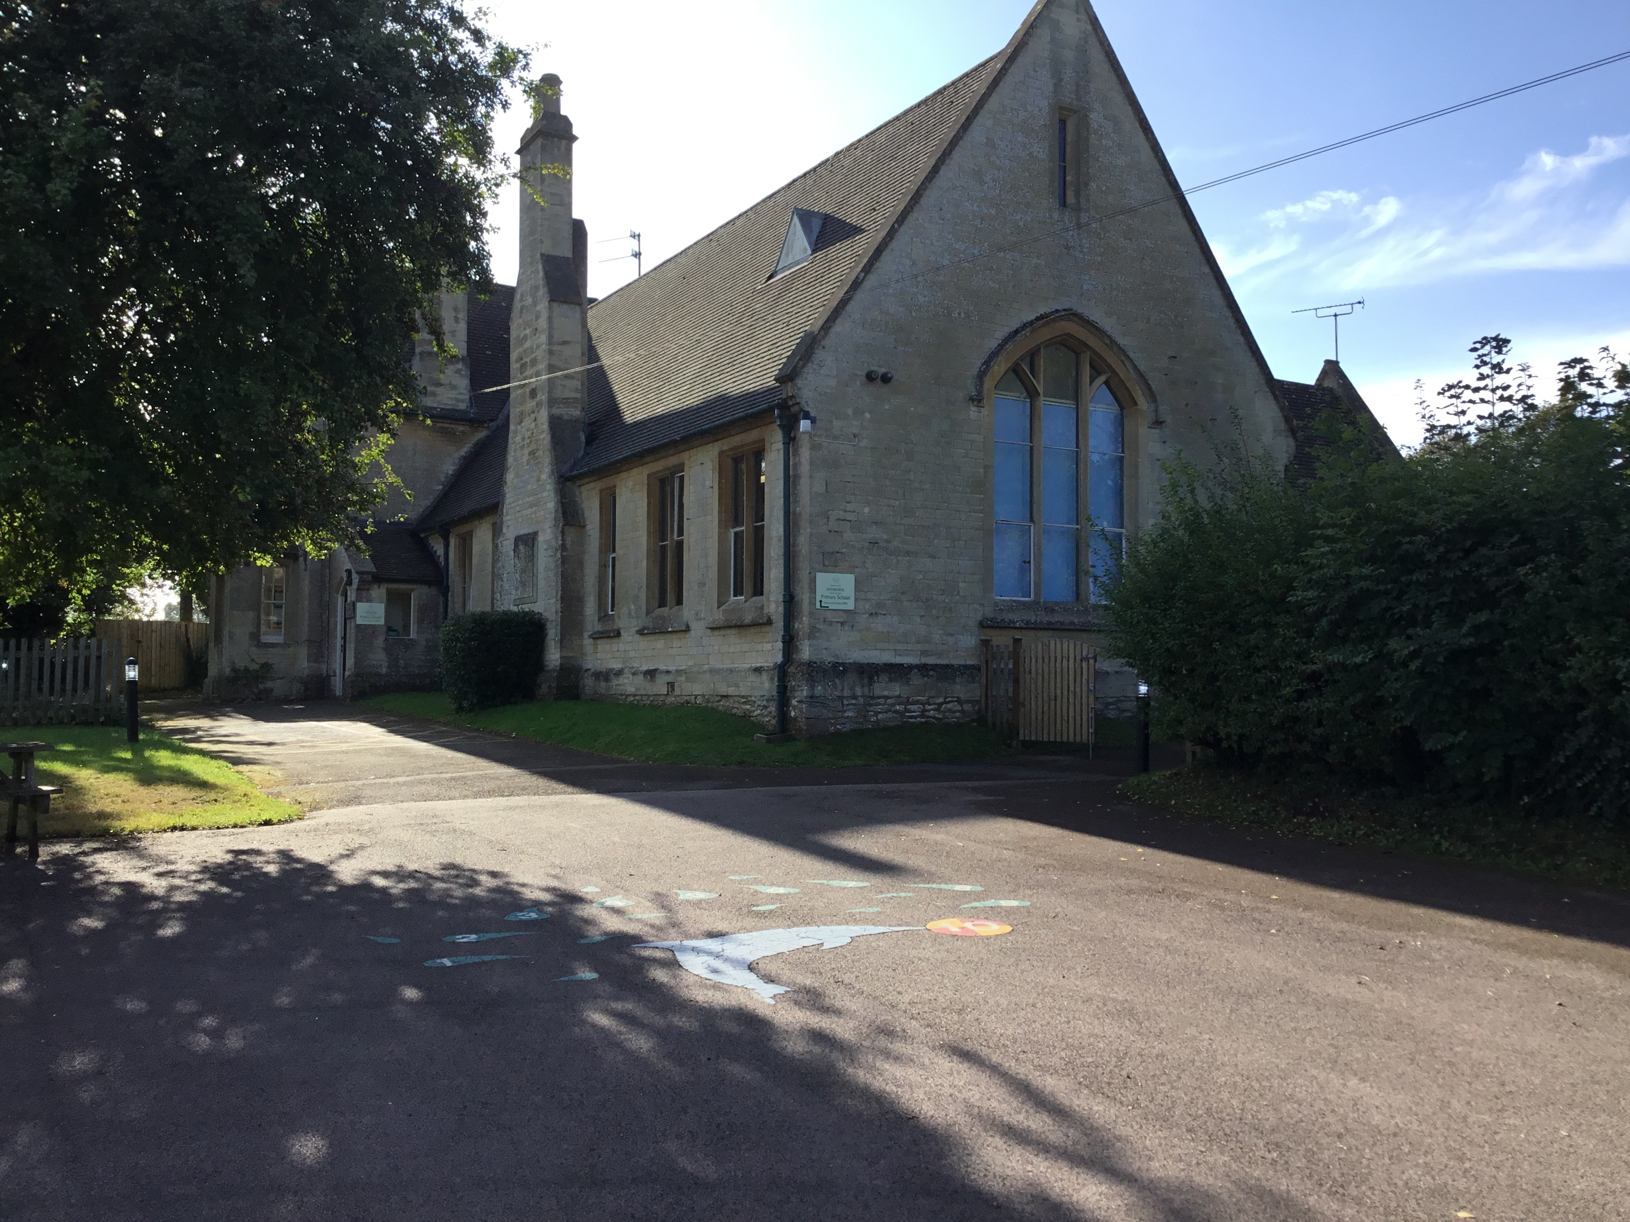
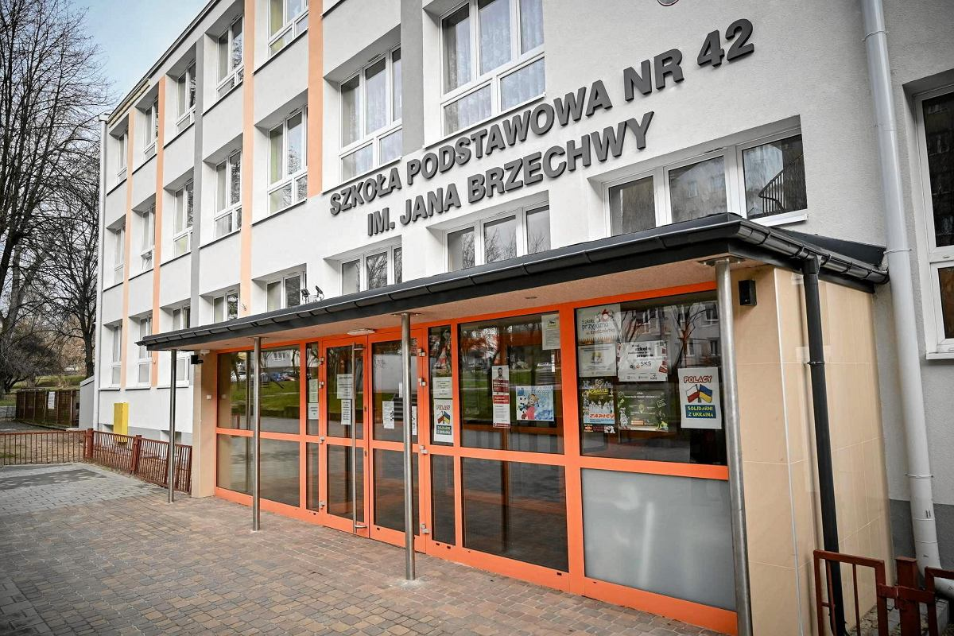
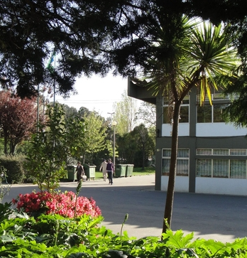
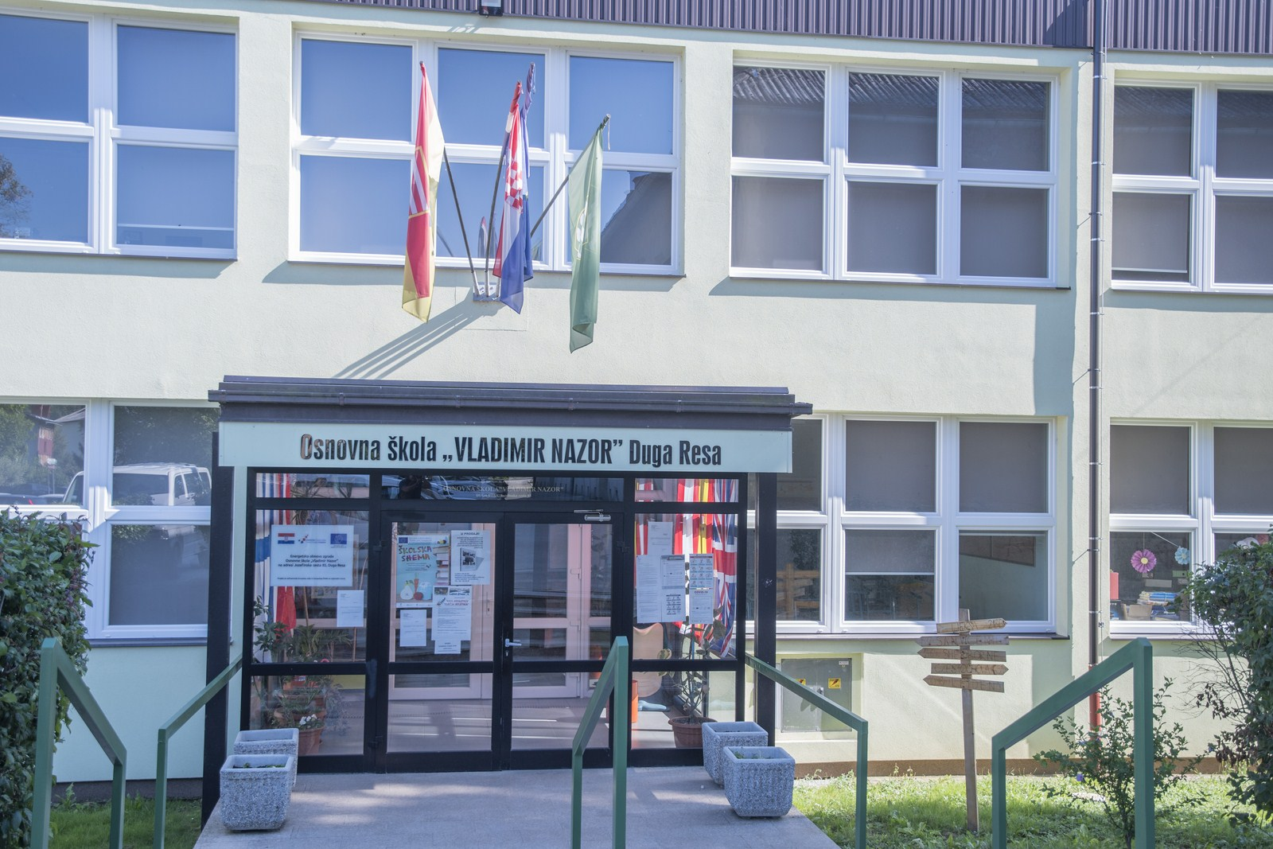
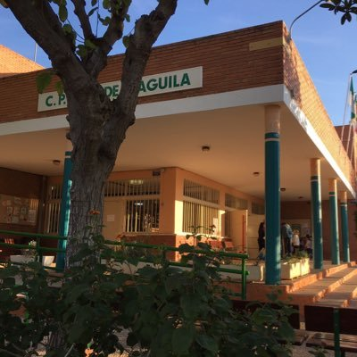
Who are the project partner schools?
982
Madonas pilsetas vidusskola, Madona - LATVIA
.
Sherborne C of E Primary School – ENGLAND (UK)
56
350
Szkola Podstawowa nr 42 im. Jana Brzechwy, Częstochowa – POLAND
.
1032
Escola Básica Gonçalo Mendes da Maia, Maia - PORTUGAL
438
Osnovna skola Vladimir Nazor, Duga Resa - CROATIA
500
Bec De L'Àguila, San Vicente - SPAIN
.

Slide 5
What will our pupils do?
Make friends and develop language skills
Research & publish information about their country’s arts culture; playwrights, musicians, artists, dancers and performers
Write playscripts
Create music/songs for performance
Record music and performances
Create original dances for performance
Make costumes, artworks and scenery
Create digital content using video, tablets & ipads
Connect countries & connect communities through visits and in a final performance

Slide 6
What will our staff do?
Make friends and develop language skills
Support pupils with research & publish information about their country’s arts culture; playwrights, musicians, artists, dancers and performers
Support development of pupils’ writing skills
Receive training to better support pupils with SEN and other specific needs
Support the learning of songs and the recording of music and performances
Support the learning of original dances for performance
Support the making of costumes, artworks and scenery
Create a Green Code for the school
Connect countries & connect communities through hosting visits, taking pupils abroad and in a final performance

Slide 7
What are the benefits?
All pupils and staff from our school are ‘connected’ to Europe and will learn from our European colleagues and friends
Long-term partnership and focus on learning through the arts
Long-term focus on improving staff and pupils’ well-being
Children with fewer opportunities and less access supported as a priority action of the project
Written and oral language skills will develop purposefully
Music, art, dance and IT skills will develop purposefully
Children will develop a better understanding of their arts’ culture
Staff will be better skilled and better trained to support diverse needs
Each school will be visited by pupils and staff from the partner schools
Generous funding for project management and implementation
Funding to support 6 pupil visits abroad to the partner schools
Funded staff training for working to improve SEND support
Funding for arts resources

Slide 8
3 – year overview
Year 1 2023-2024
Year 2 2024-2025
Year 3 2025-2026
Sept Project launch Logo | Oct Catalogue | Nov UK visit Playwriting Catalogue | Dec Catalogue Playwriting
Jan Catalogue Playwriting | Feb Catalogue Playwriting | March PT visit Music Catalogue Playwriting | April Playwriting Music
May Music | June PL visit Art Costume Music | July | Aug
Sept Music Art costume | Oct Music Art costume | Nov CT visit Art Costume Dance | Dec Art Costume Dance
Jan Art Costume Dance | Feb Art Costume Dance | March Art Costume Dance | April LT visit Drama Dance
May Dance Drama | June Dance Drama | July | Aug
Sept Dance Drama | Oct SP visit Digital media | Nov Digital media Drama | Dec Digital media Drama
Jan Digital media Drama | Feb Digital media Drama | March Digital media Drama | April Drama
May PL visit Performance | June evaluations | July Report | Aug
Pupil visit
In-school activity
Short Staff visit for interim report (funds permitting – location tbd)

